Slide 1
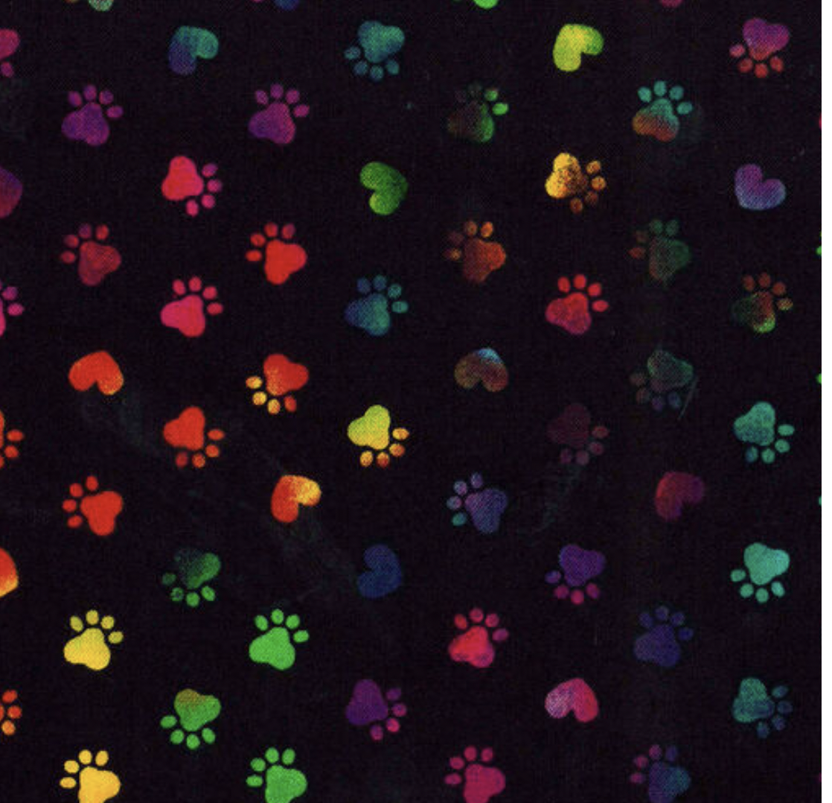
Bandana Color Chart
Paw Print
Turquoise
Magenta

