Slide 1


Resona Health Affiliate Marketing Kit
Your Complete Pamphlet & Social Media Resource Library
Welcome to the Resona Health Affiliate Program. This kit contains everything you need to promote Resona Health products — professionally designed pamphlets and ready-to-post social media images for four product lines. Download, share with your affiliate link, and start earning today.
resona.health | Affiliate Partner Program 2026

Slide 2





Your Marketing Kit Covers Four Product Lines
PTSD & The Vibe
BlueVibe & The Brain
20-page booklet + 10 social media images targeting veterans, first responders, and trauma survivors. Features 98% clinical success rate data.
18-page booklet + 10 social media images targeting cognitive wellness. Highlights MIT 40Hz research and 100% study success rate.
PEMF for Dogs
PEMF for Horses
Comprehensive booklet + 10 social media images. Focuses on pain relief, recovery, and mobility for the growing pet wellness market.
In-depth guide + 10 social media images. Targets performance, recovery, and injury management for the equestrian community.
resona.health | Affiliate Partner Program 2026

Slide 3
Two Simple Steps to Start Earning
1
2
Download Your Materials
Share Everywhere
Access the pamphlet PDFs and social media image packs from the links provided in this kit. Save them to your device so they are ready to share instantly.
Post images on social media and share pamphlets via email or messaging. Always include your unique affiliate link to ensure you get credit for every sale.
Your Unique Affiliate Link
https://resona.health/shop/?ap_id=AffiliateID
(Replace "AffiliateID" with your personal ID)
resona.health | Affiliate Partner Program 2026

Slide 4
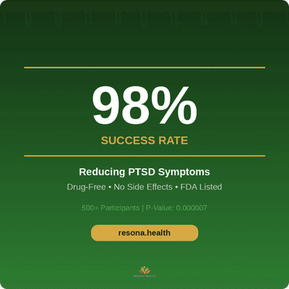

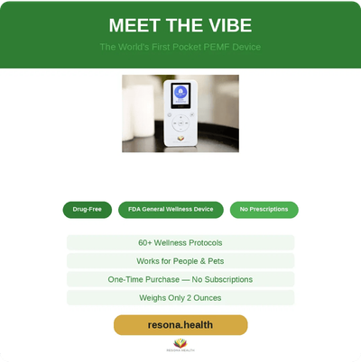

PTSD & The Vibe
98% Success Rate in Clinical Study
This 20-page professionally designed booklet covers the science behind PEMF therapy for PTSD, the clinical study results showing a 98% success rate, and the NASA-to-healing origin story of founder Mark L. Fox. It is a powerful resource for reaching veterans, first responders, and anyone affected by PTSD.
Target Audience
Veterans
First Responders
Trauma Survivors
Support Groups
DOWNLOAD PAMPHLET PDF
PTSD_and_the_Vibe_Booklet.pdf
DOWNLOAD SOCIAL MEDIA IMAGES
PTSD-Pamplet-Images.zip (10 Images)
Share with your link: https://resona.health/shop/?ap_id=AffiliateID
resona.health | Affiliate Partner Program 2026

Slide 5

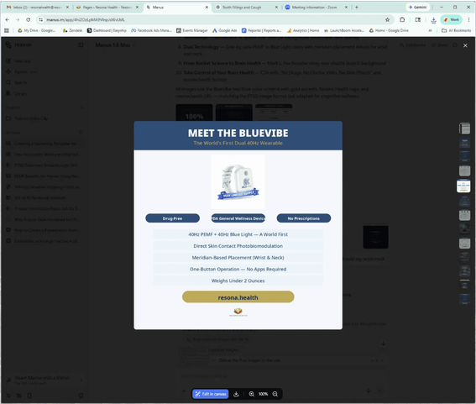
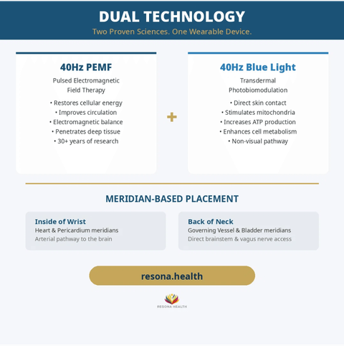
BlueVibe & The Brain — 100% Success Rate
This 18-page booklet presents the BlueVibe, the world's first dual 40Hz wearable combining PEMF and blue light photobiomodulation. It covers MIT's breakthrough research and our clinical study achieving a 100% success rate (p=0.0002).
Key Selling Points
FDA General Wellness Device • Drug-Free • No Side Effects • Meridian-Based Placement (Wrist & Neck)
Target Audience:

Adults 50+ concerned about cognitive decline

Caregivers and family members

Brain health enthusiasts & biohackers

Anyone experiencing brain fog or memory issues
Download Pamphlet PDF
Download Social Images
Your Affiliate Link:
https://resona.health/shop/?ap_id=AffiliateID
resona.health | Affiliate Partner Program 2026

Slide 6



PEMF for Dogs — Natural Healing for Your Best Friend
This comprehensive booklet covers how PEMF therapy benefits dogs, including pain relief, inflammation reduction, and faster recovery. It features real-world success stories and explains why Resona Health devices are optimized for canine wellness.
Download Your Materials
Pamphlet PDF: PEMF_For_Dogs_021826.pdf
Social Media Images (10 Pack): PEMF-For-Dogs-Book-Ads-Images.zip
Target Audience
Dog Owners
Veterinary Professionals
Pet Wellness Communities
Animal Rescue Orgs
Agility Trainers
Don't forget to share with your link: https://resona.health/shop/?ap_id=AffiliateID
resona.health | Affiliate Partner Program 2026

Slide 7

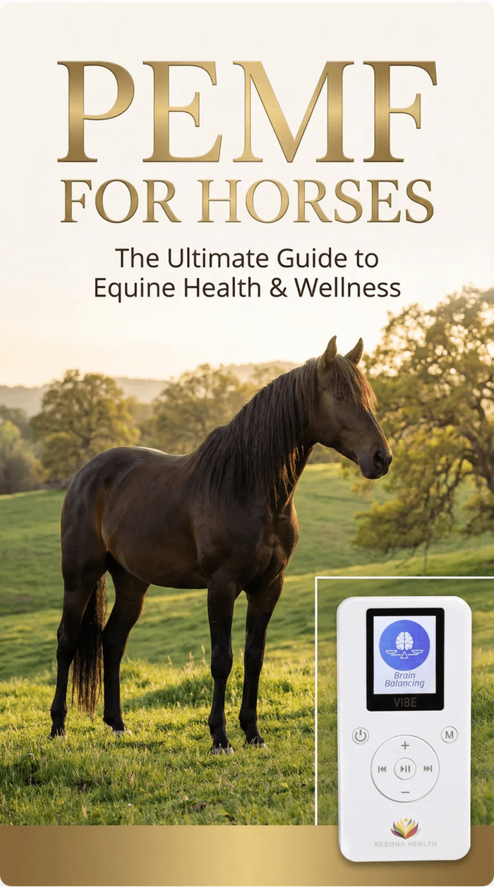



PEMF for Horses — The Ultimate Guide to Equine Health
This comprehensive booklet covers PEMF therapy for equine health, including performance enhancement, injury recovery, pain management, and overall wellness. It presents the science of PEMF in equine applications, testimonials from owners and trainers, and how Resona Health devices deliver targeted frequencies.
Target Audience
Horse owners, equestrian trainers, barn managers, equine veterinarians, rodeo and competition communities. The equestrian market is a passionate, high-spending audience.
Download Pamphlet PDF
Comprehensive Guide to Equine Health
Download Social Media Images
10 Ready-to-Post Graphics (ZIP)
Share with your link: https://resona.health/shop/?ap_id=AffiliateID
resona.health | Affiliate Partner Program 2026

Slide 8

Quick Reference — Download Everything Here
Bookmark this slide for quick access to all your marketing materials. Each product line includes a pamphlet PDF and a social media image pack.
Product Line
Pamphlet PDF
Social Media Images
PTSD & The Vibe
Download Pamphlet
Download Images
PTSD_and_the_Vibe_Booklet.pdf
PTSD-Pamplet-Images.zip
BlueVibe & The Brain
Download Pamphlet
Download Images
BlueVibe_and_the_Brain_Booklet.pdf
BlueVibe_Social_Media_Images.zip
PEMF for Dogs
Download Pamphlet
Download Images
PEMF_For_Dogs_021826.pdf
PEMF-For-Dogs-Book-Ads-Images.zip
PEMF for Horses
Download Pamphlet
Download Images
PEMF_For_Horses_021726.pdf
PEMF_Horses_Social_Media_Images.zip
All files hosted at:
https://d19878z74qufsh.cloudfront.net/wp-content/uploads/2026/02/
Your Affiliate Link: https://resona.health/shop/?ap_id=AffiliateID
resona.health | Affiliate Partner Program 2026

Slide 9





Maximize Your Earnings — Proven Strategies
Post Consistently
Target the Right Communities
Share 2-3 images per week per platform. Consistency keeps you visible in the algorithm without overwhelming your audience.
Join and engage in specific groups: Veterans (PTSD), Pet Owners (Dogs), Equestrian (Horses), and Biohacking/Wellness (BlueVibe).
Lead with the Pamphlet
The research-backed pamphlets build trust and credibility. Share them via email and direct messages for higher conversion rates than images alone.
The Golden Rule
Every post, email, and message MUST include your unique affiliate link. If they don't click your link, you don't get the commission.
Use Stories & Reels
Repurpose the social media images into Instagram Stories and Facebook Reels. Vertical video formats often get significantly more reach.
https://resona.health/shop/?ap_id=AffiliateID
resona.health | Affiliate Partner Program 2026

Slide 10




Thank You for Being a Resona Health Partner
You are part of a mission to bring natural, drug-free, science-backed wellness solutions to people and animals around the world. Every pamphlet you share and every image you post helps someone discover a better path to health. We are here to support you every step of the way.
Website:
resona.health
Your Link:
https://resona.health/shop/?ap_id=AffiliateID
Support:
affiliates@resona.health
Together, we are changing lives — naturally.
resona.health | Affiliate Partner Program 2026

